Slide 1


Accessing REST endpoint with : $http

Slide 2


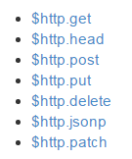
$http API
Compact "shortcut" syntax
You still can pass in additional config if needed :

Slide 3

Example
Shortcut syntax with params
https://docs.angularjs.org/api/ng/service/$http#post
Angular Shortcut gives you a param for data for : POST, PUT, PATCH
But not for : GET, HEAD, DELETE

Slide 4
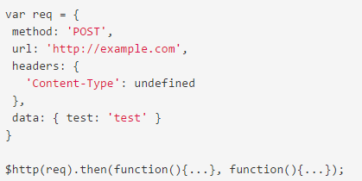
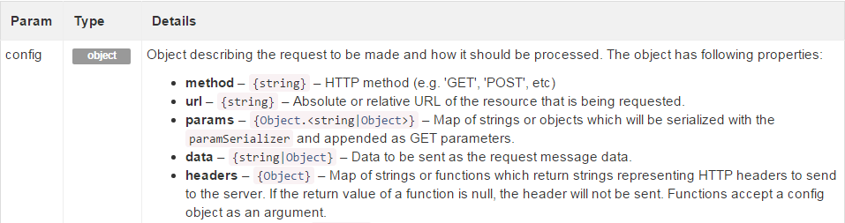
AngularJS $http
The full flexible syntax
The config param is called req in this example
And many other params…
Notes:
var req = { method: 'POST', url: 'http://example.com', headers: { 'Content-Type': undefined }, data: { test: 'test' } }
$http(req).success(function(){...}).error(function(){...});

Slide 5
$http
by default no string interpolation in angular 1.x
With $http you don't have fancy tools to build the URL, you have to build the URL string yourself
'/myapp/film/' + myVarId
Note : in ES2015 just use string interpolation : use the back tick `
var myVarId = 5;
var url = ` '/myapp/film/${myVarId}`;
The url will be be automatically filled depending of the scope context
=> here : url = " /myapp/film/5";

Slide 6
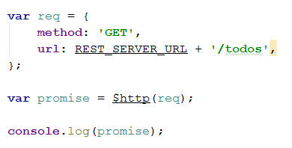
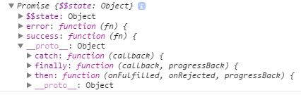

AngularJS
$http promise and callbacks
⬄
2 styles of Callbacks
Promise style API : then() , catch(), finally()
"JQuery" Style API : success(), error()

Slide 7
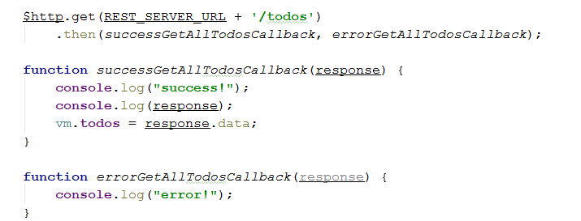
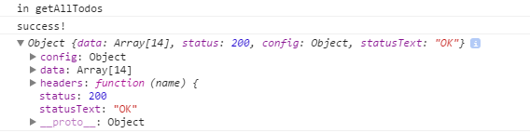
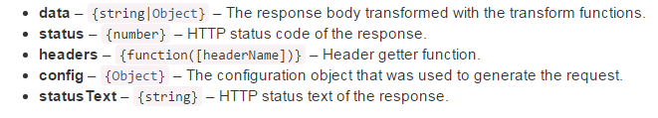
$http callbacks with the "then" style syntax (Promise Style)
Almost a Promise but not quite !

Slide 8
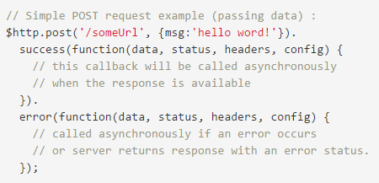
$http callbacks "jquery" style
If you choose "jquery" style syntax : success() and error() callbacks
params for callback functions in success() and error()
the status param is NOT available as a function param)

Slide 9
$http and its (almost regular) promises

Slide 10

DEMO on todo
Beware of data resolution
On a regular promise the callback directly receives the data

Slide 11
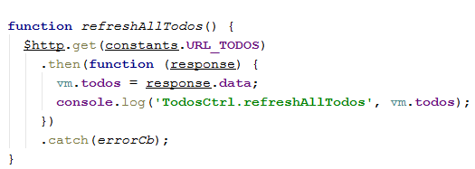
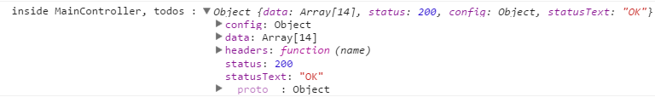
DEMO on todo
Example inside a controller
With the $http promise you get the Http response containing the data.
Detail of the received promise :

Slide 12
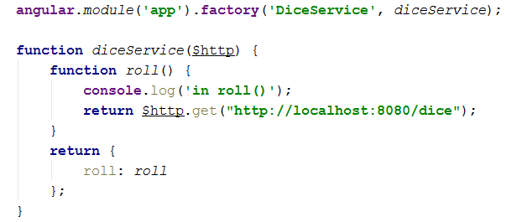
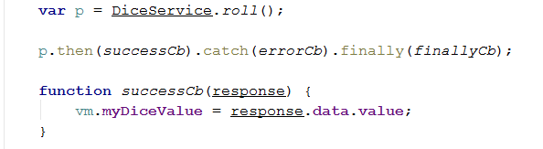
DEMO on todo
Raw service returning a Promise
Client controller code calling the service and receiving a Promise

Slide 13
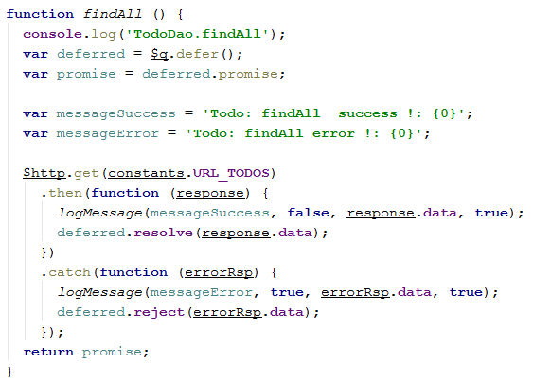
DEMO on todo
Example of a DAO, using a Promise
It is better to extract the data inside a service, not in the client code, and return real standard Promise to your client code . Code extract from TodoDao.js

Slide 14
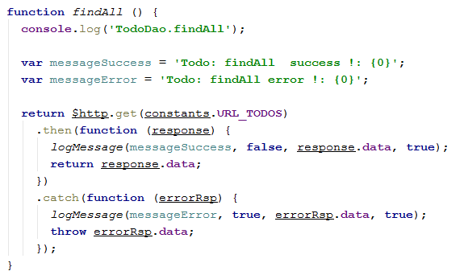
DEMO on todo
Example of a DAO
Same goal as previour slide but with the Angular Magic Return on $http Code extract from TodoDao.js
magic return

Slide 15
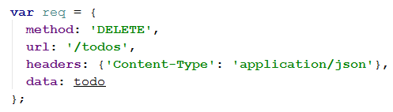
$http.delete limitation
the syntax $http.delete() can not have an Http RequestBody … no parameter fr it in the method signature. So no JSON payload is possible
It 's OK if you have an URL like : url = /todos/:id/:version
$http.delete( url ) will work
But with a url like : url = /todos + JSON payload of an object containing id and version property, you can't use $http.delete()
instead user the full explicit API :

Slide 16
AngularJS
PluralSight Angular Best Practices by Joe Eames
Chapter 8 : server communication $resource $http RestAngular
Packt Book : Mastering Web Application Development with AngularJS
Chapter 3 : Communicating with a Back-end Server
APRESS PRO AngularJS page 555 top

